Slide 1
TEAM DETAILS
TEAM NAME: INNOVATORS
TEAM LEADER NAME: NAVISHTHI GUPTA
INSTITUTE NAME: ALLIANCE UNIVERSITY
THEME NAME: AI-POWERED SPACE STATION MONITORING
TEAM LEADER EMAIL ID : navishthigupta01@gmail.com

Slide 2
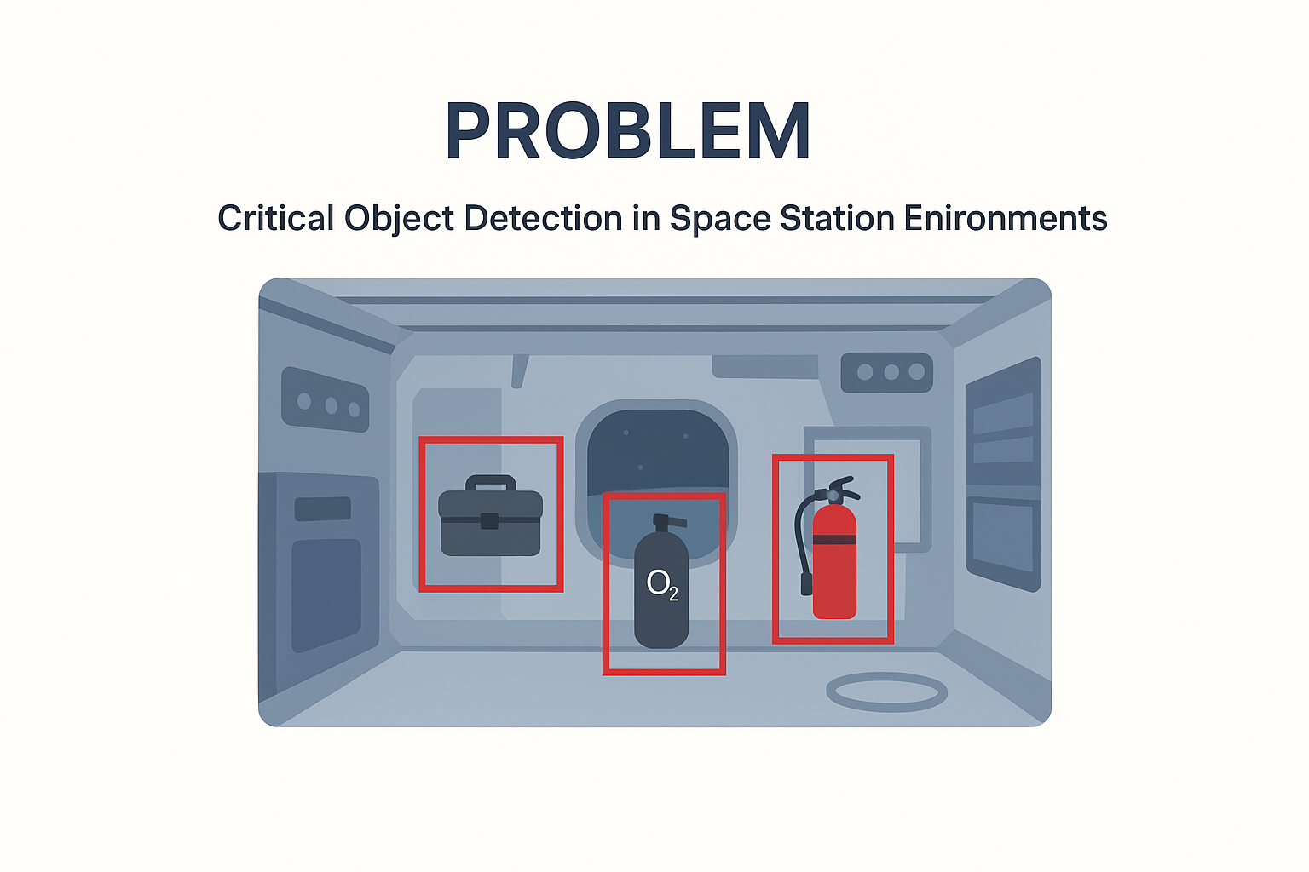
PROBLEM
The space station is cluttered and messy, with objects floating around in microgravity.
Lighting changes drastically every 90 minutes as the station orbits Earth.
Objects often get obstructed, overlapped, or seen from unusual angles.
In emergencies, astronauts cannot afford to waste time searching for critical items (oxygen tank, fire extinguisher, toolbox).
Collecting real-world space data is costly, rare, and limited.
Traditional AI models, trained on Earth data, struggle to perform under these space-specific challenges.

Slide 3
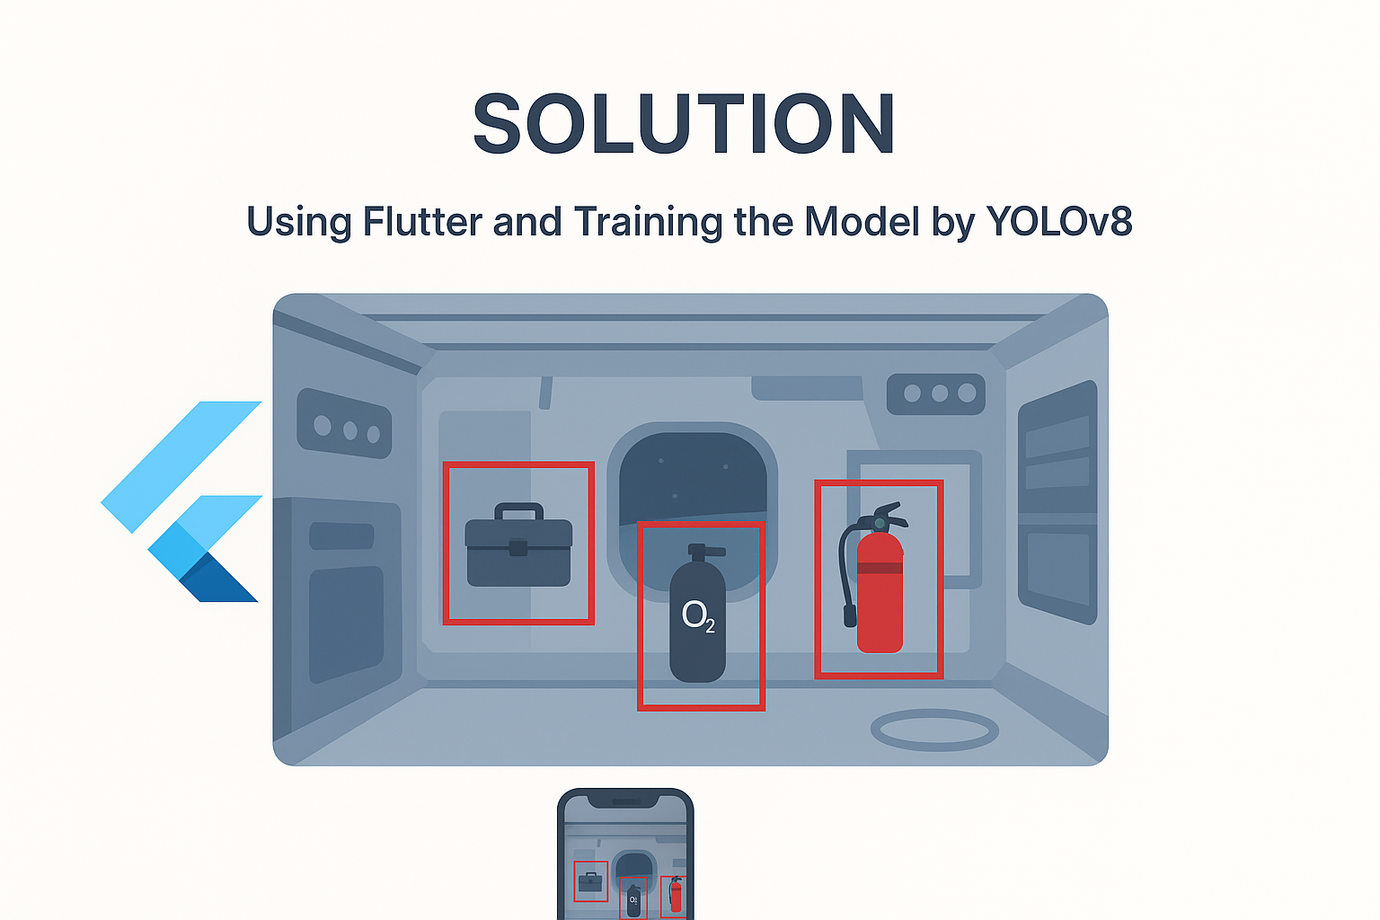
SOLUTION
Model Training with YOLOv8
Dataset: Falcon’s synthetic space station dataset .
Preprocess → split into train, validation, test sets.
Train with YOLOv8 + hyperparameter tuning.
Optimize with augmentation (lighting, occlusions).
Evaluate using Precision, Recall, confusion matrix.
Export final weights.
Application Development with Flutter
Cross-platform (Android,Desktop).
User-friendly UI for astronauts & mission control.
Integration: Convert YOLOv8 → TensorFlow Lite → run in app.
Real-time detection via camera or images.
Bounding boxes & labels for critical objects.

Slide 4
Features of the App
Real-time object detection (toolbox, oxygen tank, fire extinguisher).
Alerts: Visual for missing or misplaced objects.
Offline capability (works without internet).
Human Impact
A “smart assistant” to instantly locate life-saving tools.
Saves time in emergencies.
Improves safety, efficiency, and mission reliability.

Slide 5
METHODOLOGY & IMPLEMENTATION
Dataset Preparation
Create synthetic dataset using Falcon's Digital Twin platform.
Objects: Toolbox, Oxygen Tank, Fire Extinguisher.
Preprocess data and divide into Train / Validation / Test sets.
Model Training (YOLOv8)
Create environment using Anaconda + dependencies.
Train YOLOv8 on Falcon dataset with hyperparameter tuning.
Use data augmentation (lighting variations, occlusion management).

Slide 6
Optimization & Validation
Inspect confusion matrix & failure cases.
Fine-tune model to better recall & accuracy.
Save final trained weights (best.pt).
Application Development (Flutter)
Convert YOLOv8 model → TensorFlow Lite for deployment.
Create cross-platform Flutter app (Android, iOS, Web, Desktop).
Incorporate camera stream / image input for real-time detection.
Show results with bounding boxes + labels.
Testing & Deployment
Test app in simulated conditions with synthetic scenarios.
Support offline capability for space environment.
Allow continuous updates from Falcon retrained models.

Slide 7
TECHNOLOGY USED
Falcon (Duality AI) → Digital Twin simulation platform for generating synthetic space station datasets.
YOLOv8 (Ultralytics) → State-of-the-art deep learning model for real-time object detection.
Python → Training, pre-processing, evaluation (Precision, Recall, Confusion Matrix).
Anaconda → Environment management for dependencies.
TensorFlow Lite → Model conversion for deployment on devices.
Flutter → Cross-platform app development (Android, iOS, Web, Desktop).
Visualization Tools → Confusion matrices, performance graphs, bounding box overlays.

Slide 8
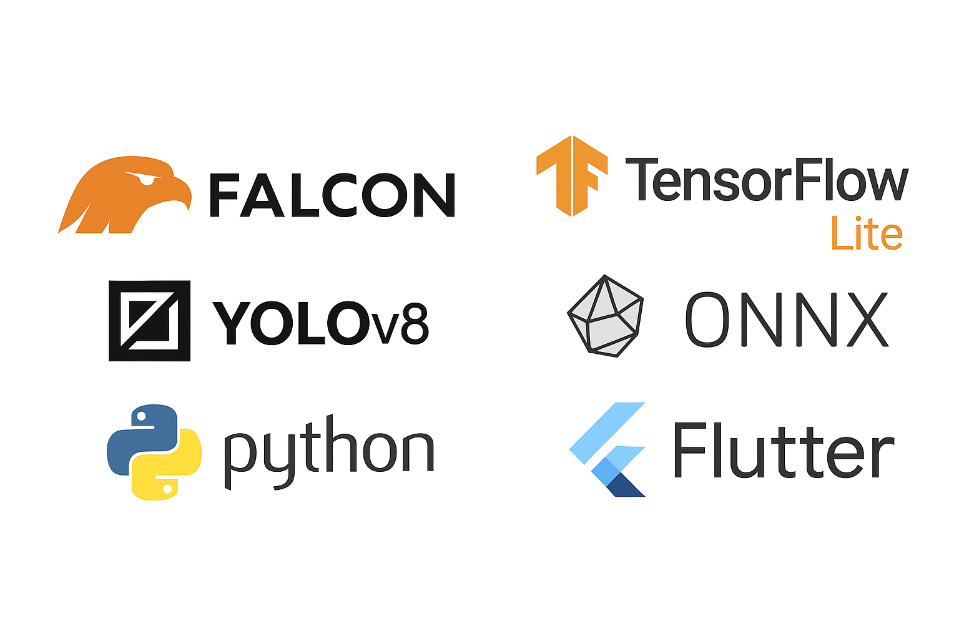
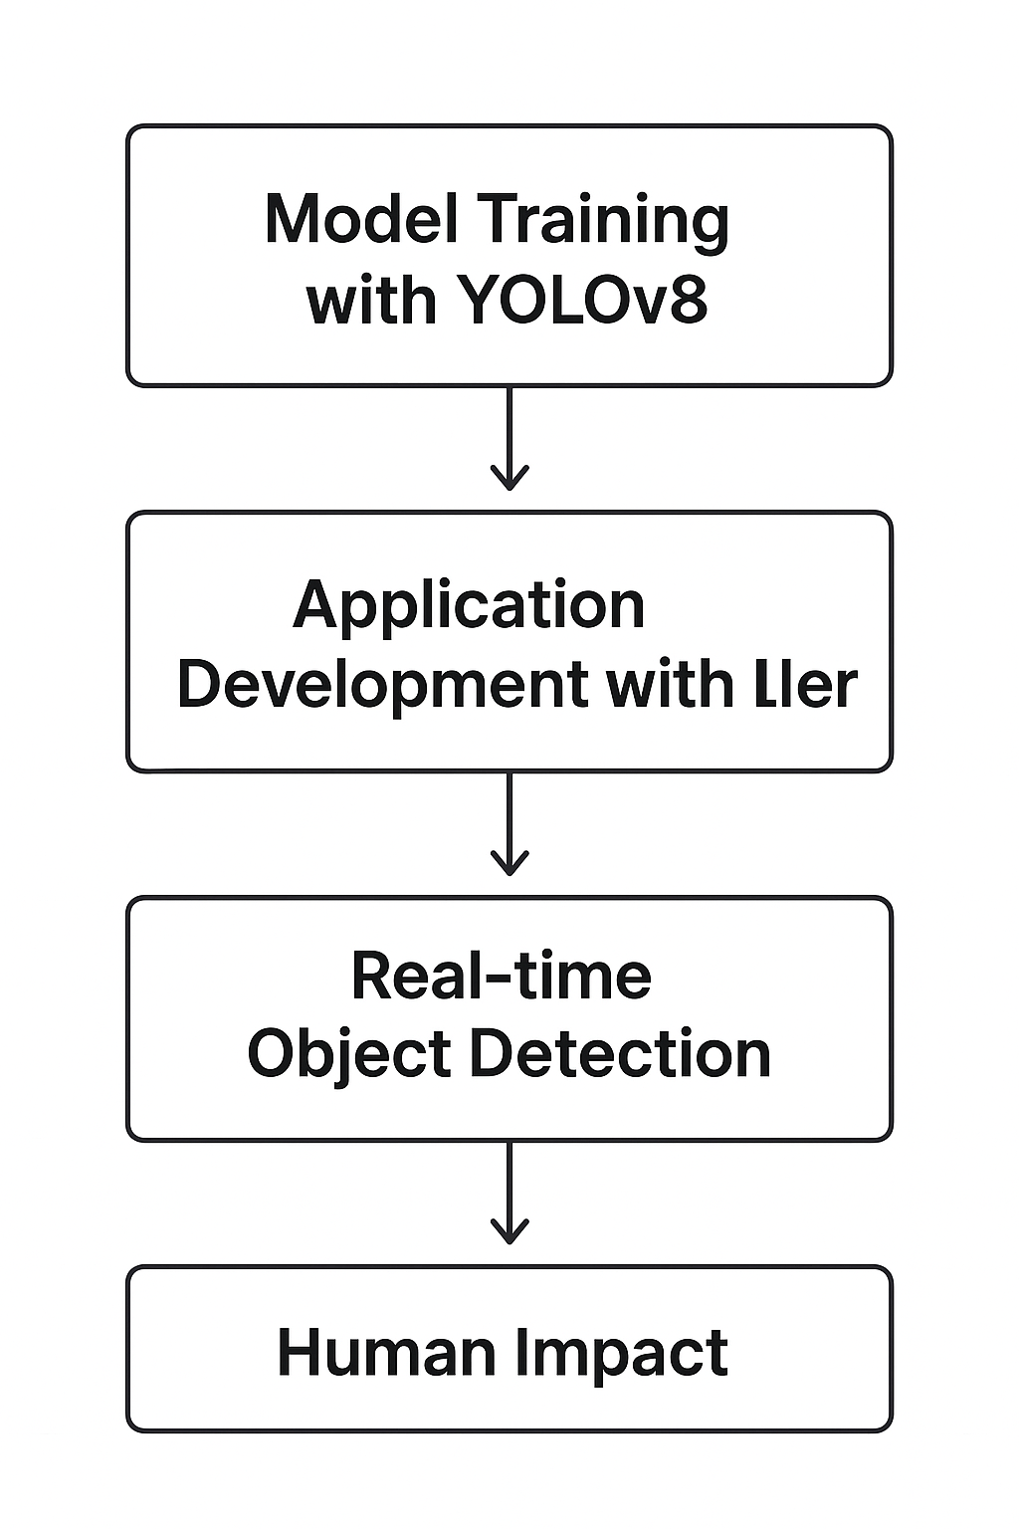
FLOWCHART & SUPPORTING IMAGES

Slide 9
FEASIBILITY & MARKET USES
FEASIBILITY
Synthetic Falcon data guarantees scalability.
YOLOv8 is accurate, light, and deployable.
Flutter facilitates cross-platform, offline-capable apps.
Affordable as opposed to real space data acquisition.
MARKET USES
Space missions: rapid tool/equipment detection.
Aerospace & defense: safety-critical monitoring.
Robotics & automation: object detection in challenging environments.

Slide 10
CONCLUSION
Utilized Falcon synthetic data and YOLOv8 to create a solid object detection model.
Integrated into a Flutter application for real-time, cross-platform deployment.
Gives astronauts an intelligent assistant to rapidly find vital objects.
Improves safety, efficiency, and reliability of space missions.
Scalable to future applications in aerospace, defense, robotics, and more.

Slide 11


